Slide 1
UX design update
CreditLens
August 2018

Slide 2
New customer, River Construction and Byers Brothers, of Circle Bank
A new customer, called River Construction, is requesting a mortgage and construction loan on a new commercial land development area, from the ground up. Total costs of the land and new construction is totaled at 9,200,000 USD.
Specific requests:
Mortgage Loan at 6,000,000
Construction Loan at 3,200,000
In addition, a new customer, called Byers Brothers, is guaranteeing the loans.

Slide 3

Malik, Credit Analyst of Circle Bank
Malik
Age: 27
Credit Analyst
Malik is tasked with setting up the new customers and making sure the credit presentation of the entire deal, can be presented to the credit decision group, for final approval.
Malik is a new user to CreditLens, so may not know all the details of how everything works. Would expect navigation to be intuitive and easy to understand.
Note: Some customers may use Workflow to set this up, or may not use Workflow.

Slide 4
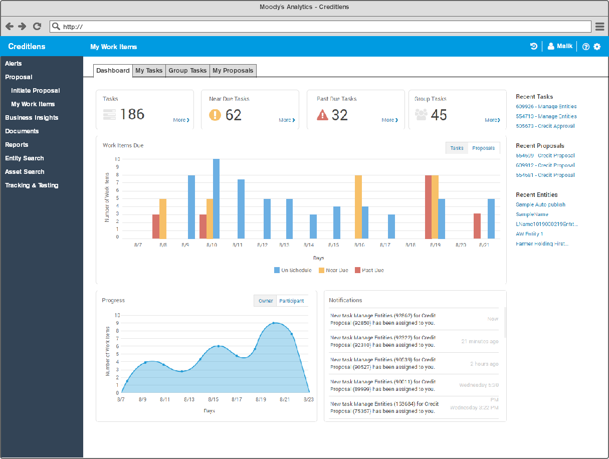
Malik logs into CreditLens, to the Work Items dashboard

Slide 5
Malik realizes there are a lot of menu options
As a newer user, Malik realizes there are lot of menu options and isn’t exactly sure where to go next. The menu is a bit cluttered with contents, depending what level of access he has. If full access, he sees quite a few options. He doesn’t want to have to sift through contents.

Slide 6
Overall navigation
Too many navigation items on the left nav, remove some and put elsewhere and use top blue bar for global items. Too many left nav items makes the navigation process confusing for the users, with added clutter to sift through.
Potentially show all left navigation items to be open, where user does not need to first click to view what is in the menu. At first glance, a user will not know what is under a nav item. This also removes extra clicks.

Slide 7
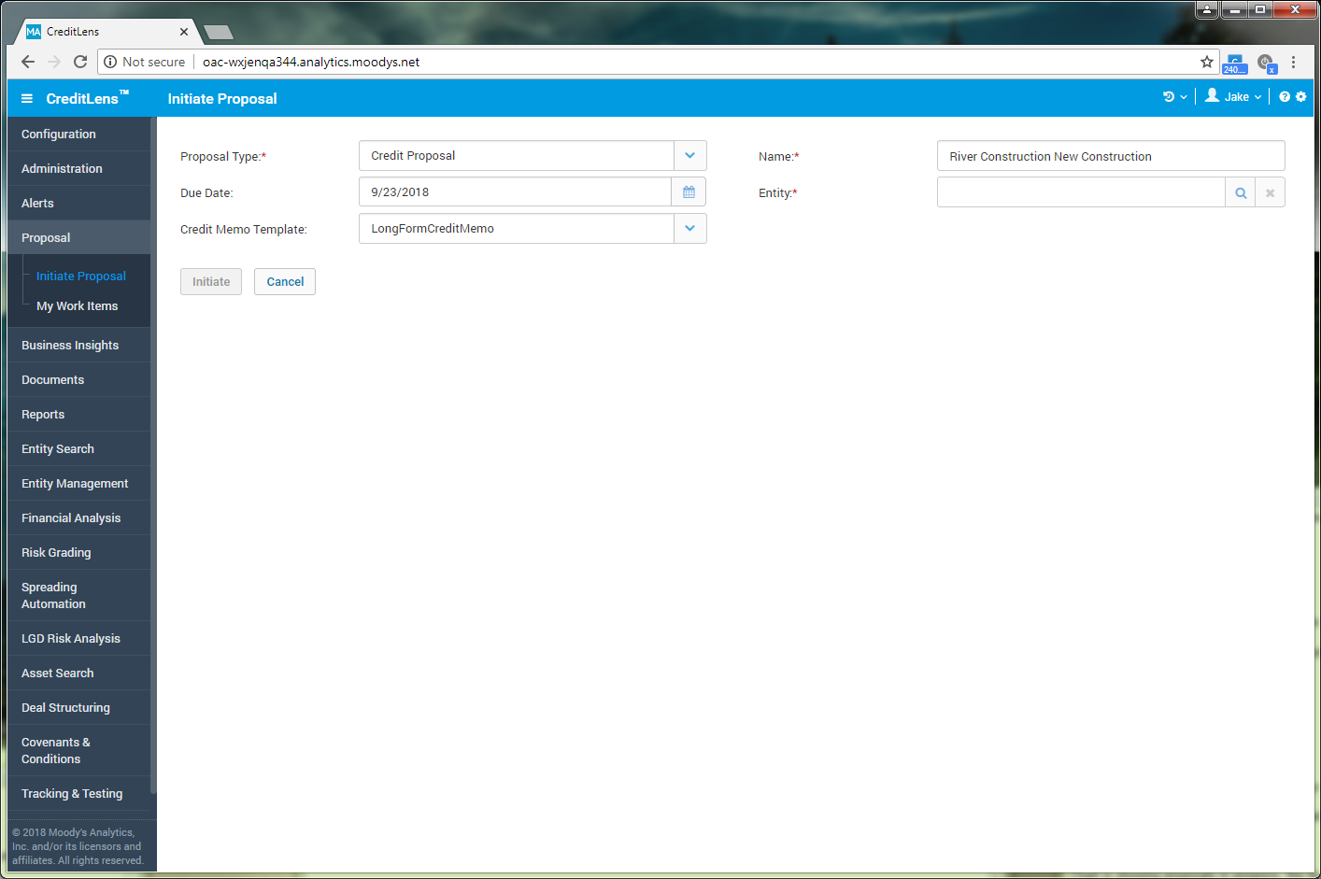
Malik initiates a new proposal

Slide 8
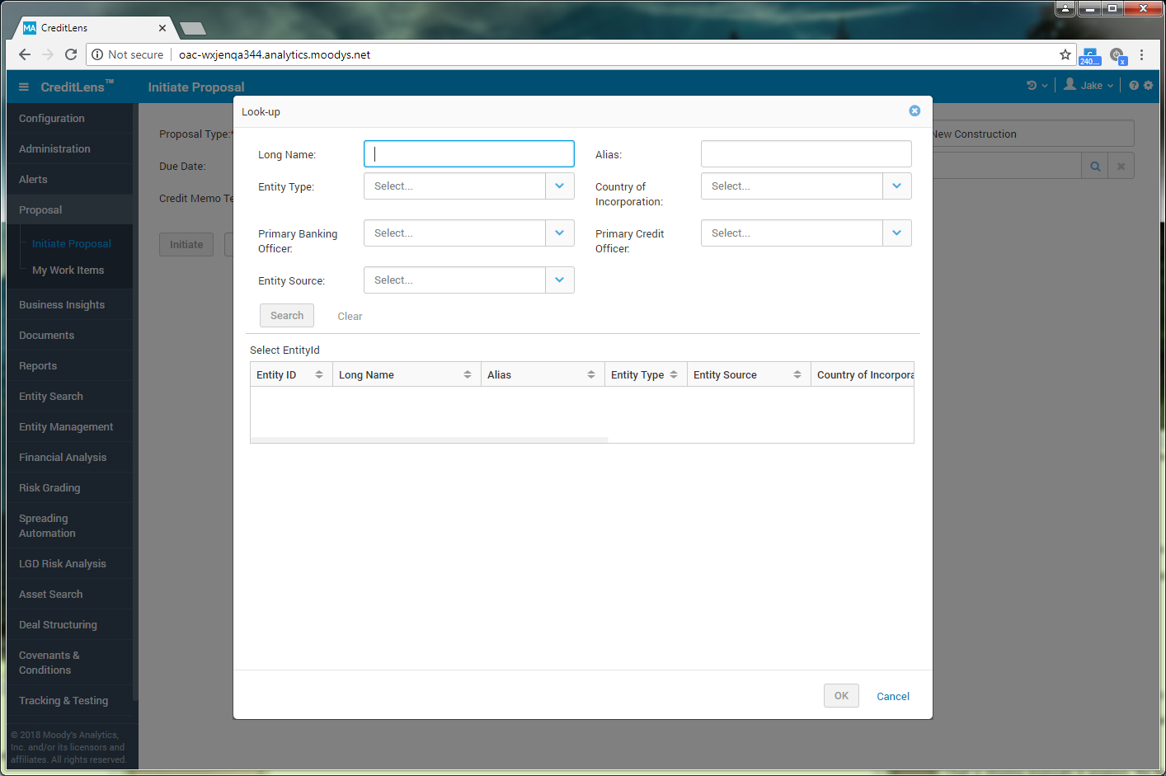
Initiate proposal lookup, add quick create entities
Upon the creation of proposal, Malik knows the entity doesn’t exist, so upon lookup he can quick add the entities from this screen.
Action Item: Add quick create of entities on initiate proposal.

Slide 9
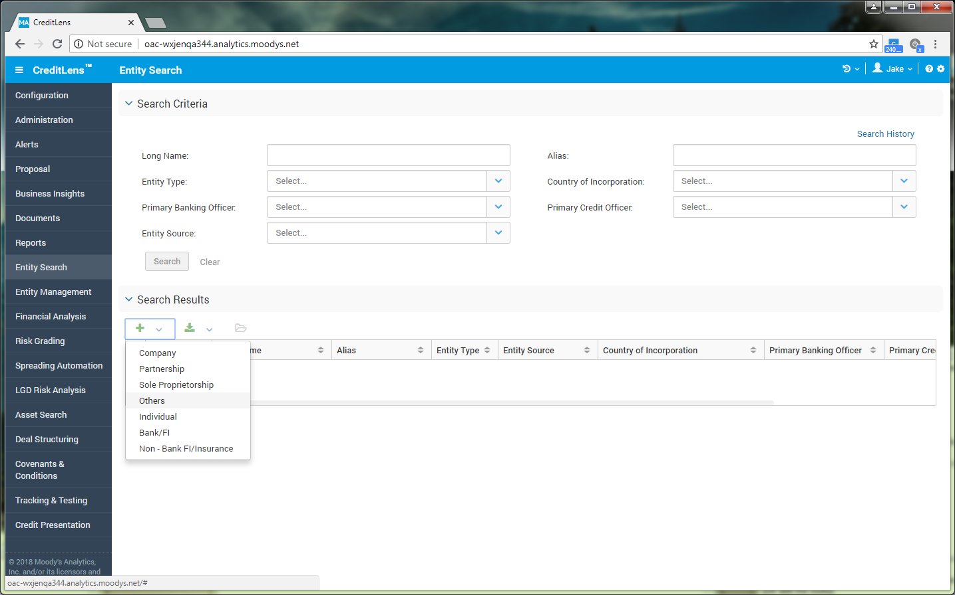
Malik goes to entity search to add new entity
Instead, Malik has to come to Entity search first, and click the search results accordion to open first, then click to add the new entities.

Slide 10
Quick search added to the header
Removal of a few clicks. Malik does not have to first go to entity search. Can search from any screen, without clicking into the left menu.

Slide 11
Quick search added to the header
Malik first does a search for River Construction Company and realizes it is not there.
Notes: May have to start with just entity search but ideal to search assets and other items, grouped by type. An entity, facility, asset, document, anything that could be searchable.

Slide 12
Click expand icon to view full screen search criteria
Malik wants to enter more search criteria, so he can click the expand icon to view the search in full screen, if he wants to search by additional criteria.

Slide 13
Consideration of moving global elements into header
Links that could be added to the header, that are more global in nature, to remove extra links on the left. Would need further research.

Slide 14
Malik realizes that River Construction doesn’t exist
Showing the option of create new under each section of the search results.
Notes: Again, if it is important that Malik would search first, before adding, the options of adding new could be under the actual search results.

Slide 15
River Construction does exist
Malik wants to review or add new facilities or assets to the existing entity, amendment or annual review. He can quickly see an overview of items tied to this entity.

Slide 16
Malik realizes that River Construction doesn’t exist
Malik sees that River Construction doesn’t exist, so he can click the create new button to quickly add the entity.
Notes: The Quick add new button could be better if it was added next to the Entities row in the search result field above, one next to assets, one next to documents, also. If it’s important that Malik searches first, before the ability to add new.

Slide 17
Malik clicks to add new, which brings up options
Malik wants to add all of the items at once, instead of separately. He feels it will save him time. He clicks on “Custom”.

Slide 18
Malik is custom adding his content
Malik wants to add all of the items at once, instead of separately. He feels it will save him time. He clicks on “Custom”.
Notes: This process may work best in the actual page, versus a modal. This would have to be thought through more.

Slide 19
Malik is custom adding his content
Malik is entering the first entity of two.

Slide 20
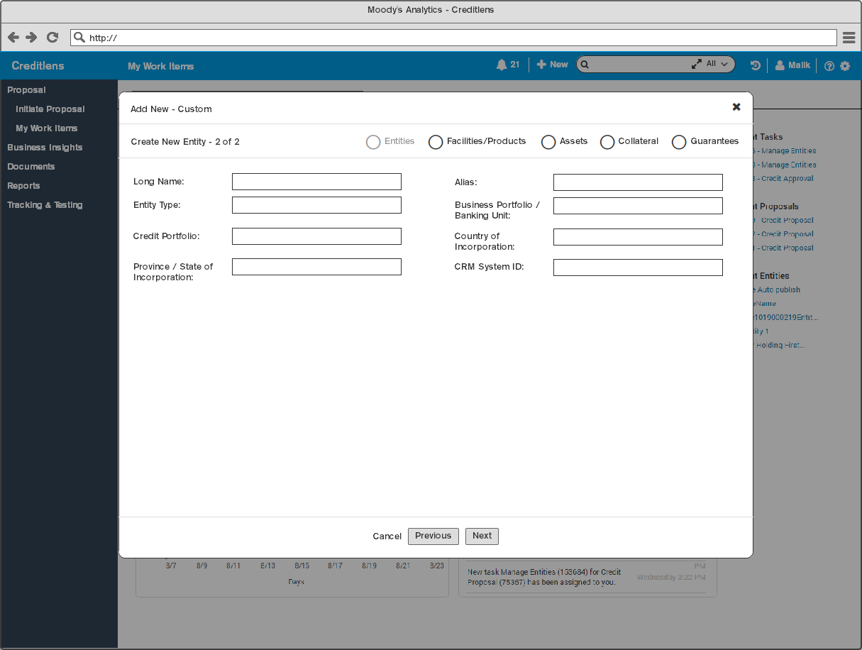
Malik is custom adding his content
Malik is entering entity two of two.

Slide 21
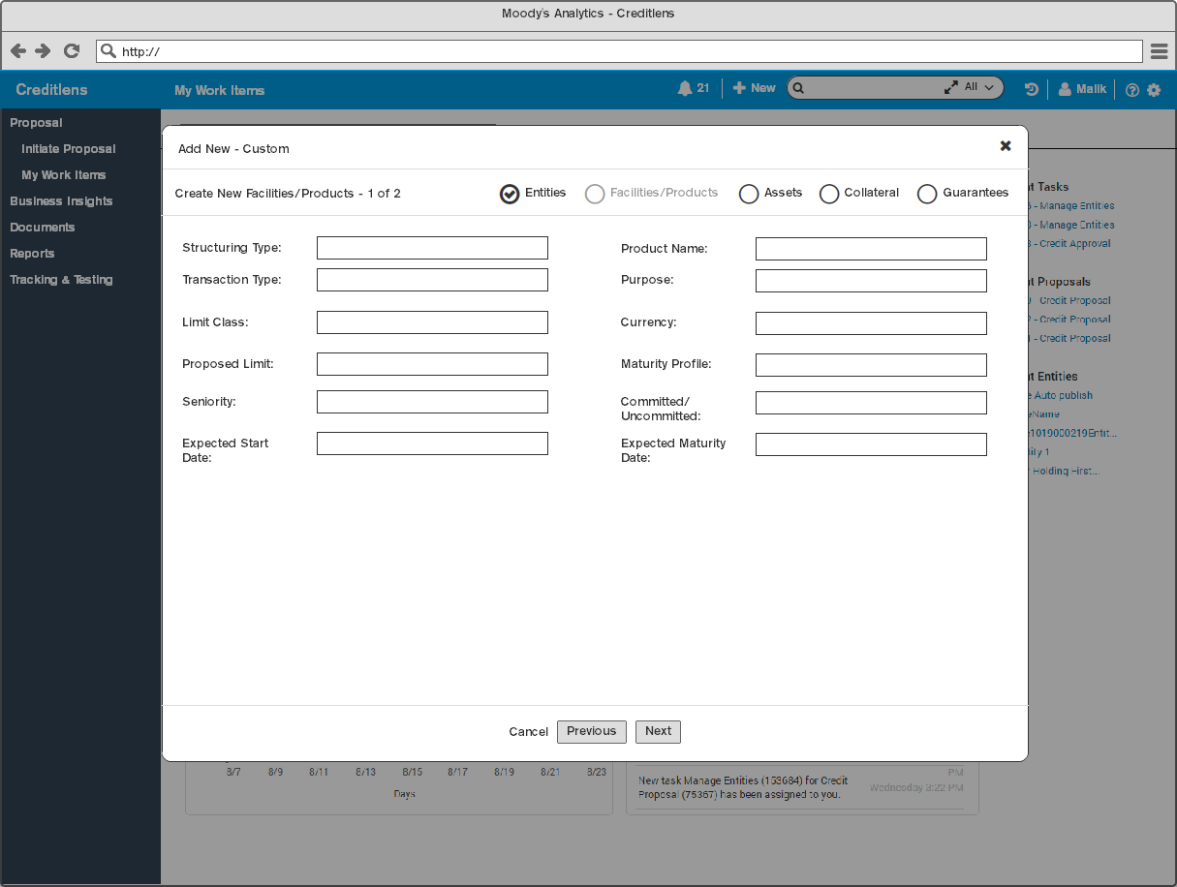
Malik is custom adding his content
Malik is entering the 1st facility/product.

Slide 22

Malik is custom adding his content
Malik is adding the assets.

Slide 23

Malik is custom adding his content
Malik is adding the collateral.
Notes: We will have to have the ability to associate loans/assets and entities together, ect.

Slide 24
Malik finalizes the adding process
Malik is viewing an individual asset, after he added all of the contents. The summary of all items associated with this asset, is viewable to the right. He can quickly scan the associations or add new or view details, as needed.

Slide 25
Malik can view this overview from any tied item
Malik is viewing the entity he created and can also view this same overview content from the items related to this entity.

Slide 26
Malik wants to add additional items
If Malik is in an entity and wants to add a few more items to it, he could click to add custom groups of elements, similar to the global create new in the header.

Slide 27
Global elements, navigation at the top
A more clear hierarchy on the page. Malik can switch between major global functions of CreditLens, knowing where he is in the application, more clearly, without having to be on a certain page. Can switch between editing an entity and going into Workflow, for example. Proposition of a more clear separation between being in Workflow or not. Use of empty space, as well, for useful functionality.
Functions only then related to the entity the user is in, so it’s more clear and the left nav is less cluttered and more focused. This then allows the potential to push more content from the pages themselves (pages with “too many tabs”, extra tabs, accordions, into the left navigation. No click to open links.

Slide 28
Global elements, navigation open
Examples of more global elements or functionality that could be added to this menu.

Slide 29
In Proposal Center, all below blue nav can be used
Global dashboard for Proposal Center, more clearly separating from actually editing entities, ect.

Slide 30
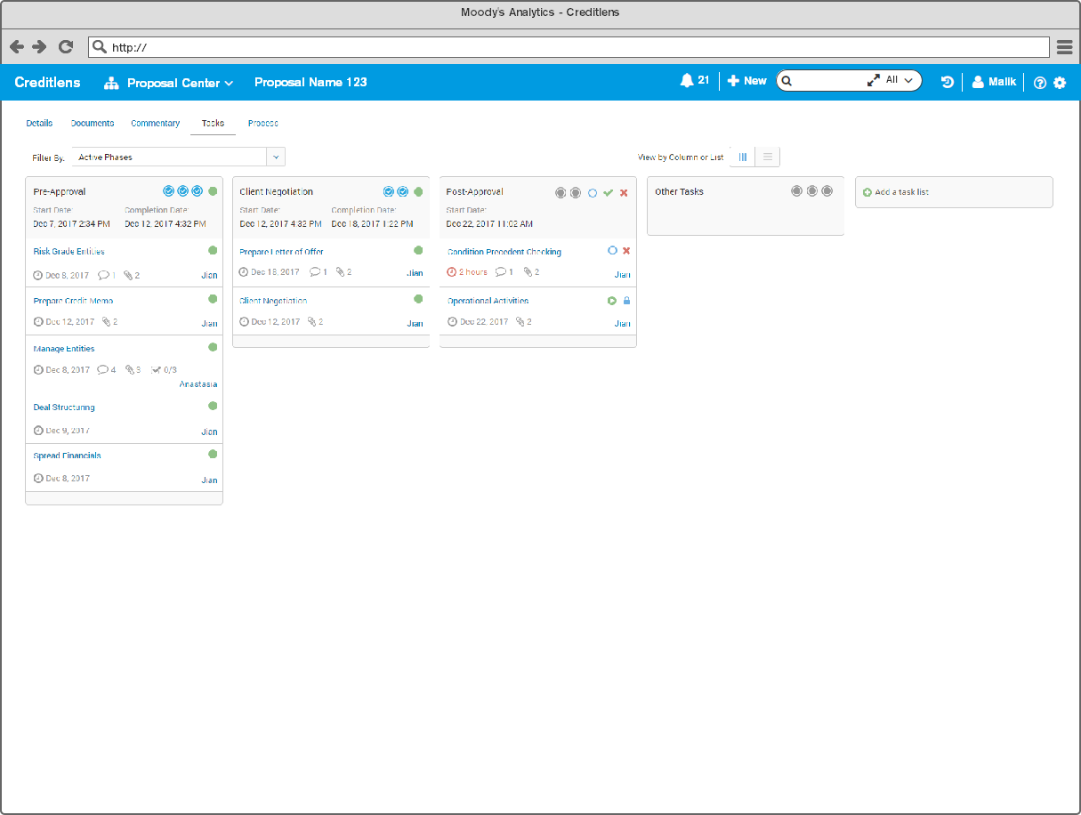
In a selected proposal, and task list
Allow potential use of full screen for tasks and proposal content.

Slide 31
Ultimately the rating of the entity and the ratings of the loans, in the credit presentations and can drill into details if they want to. But they want to see the probability of default and if the deal is going to go through and the bank will be paid back.
Quick way to view credit presentations? Tied to the entity or deals? Proposals based on the entity or tied to it?
Quick create of items in a modal when adding. What do you want to do? Create this, deal, entity, asset, what else. Where do I go after?
Move some nav items to the right or elsewhere.
Quick create/jump from entity or asset or quick move to other parts of the entity, an entity specific nav of some kind.
Create new as a dropdown or elements in the modal?
In modal, select what you want to create? Checkboxes of what you want, entity, asset, deal, ect., what else?
Create new, with checkboxes of what you want to create.
Expand icons in the header of the search.
A preview view of the search, say, I click to preview the search results.
Expand the create new page? Can select what entities that you want to add to, on a top box and then below, you can select what you want to add or edit. Say I want to select an entity first, then add an asset, facility, collateral, ect., to the entity.
A facility hierarchy already exists, for creating the facility structure.
Remove clutter left nav: remove proposal/workflow from nav, add to header also. Add global elements not tied to an entity to the header, to allow things to be more clear as to what user can focus on in left menu for entity only. Entity only content in left menu, to a degree. Documents maybe not, not sure. Reports? What are global elements not tied to an entity?

Slide 32

Disclosure
Information regarding products, features, specifications and functionality in Moody’s Analytics product design document is intended to outline Moody’s Analytics general product direction but is not guaranteed. Future products will be sold only when and if available. Moody’s Analytics reserves our right to change the development, release, and timing of features and functionality discussed in our product design at anytime.
Situations discussed as examples are fictitious and intended only to illustrate examples of possible use.

